Slide 1

Analysis about Tennis Players’ Type and Winning Strategies
Minyong Lee
EAS345 12/08/2022

Slide 2

Overview
Problem
Definition
Data
Collection
Data
Cleaning
Modeling & Analysis
Data
Product
EDA

Slide 3
1. Problem Definition
0 1
How can we classify the types of tennis player based on the player data?
0 2
There are traditional winning strategies for each type. Can we verify them through real data?

Slide 4
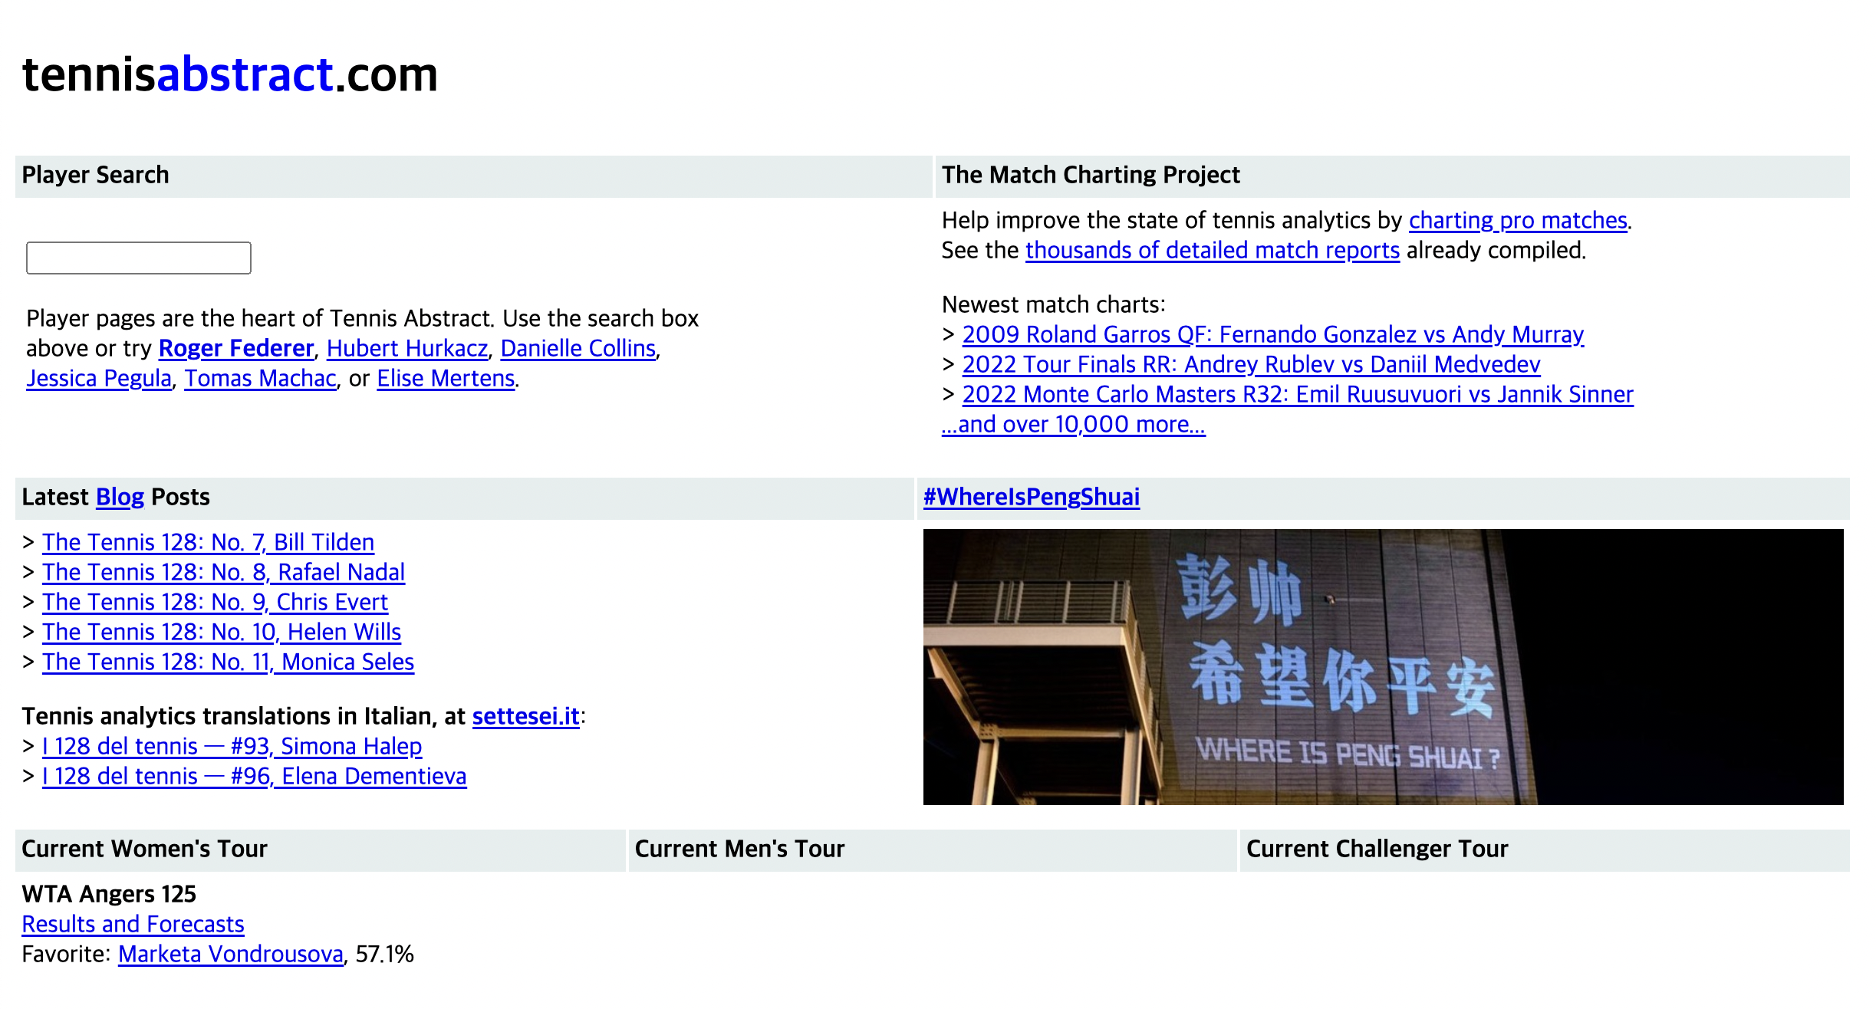
2. Data Collection

Slide 5
2. Data Collection
Data about 3,608 matches from 1960 to 2022
Data about 619,647 points (for every each point)
Data about lots of other stats related to tennis players
ex) serve, shot types, shot direction, net points and so on…

Slide 6
3. Data Cleaning
18 datasets
representing each
element of tennis
Character type of
the match date
ex) 20221208
Column that contains
two information
(game#, seq# in game)
NAs and
invalid values
4 reorganized datasets
that contain only
the data I need
Date type of
the match date
ex) 2022-12-08
Remove them
from the datasets
Divide it into two
separate columns

Slide 7
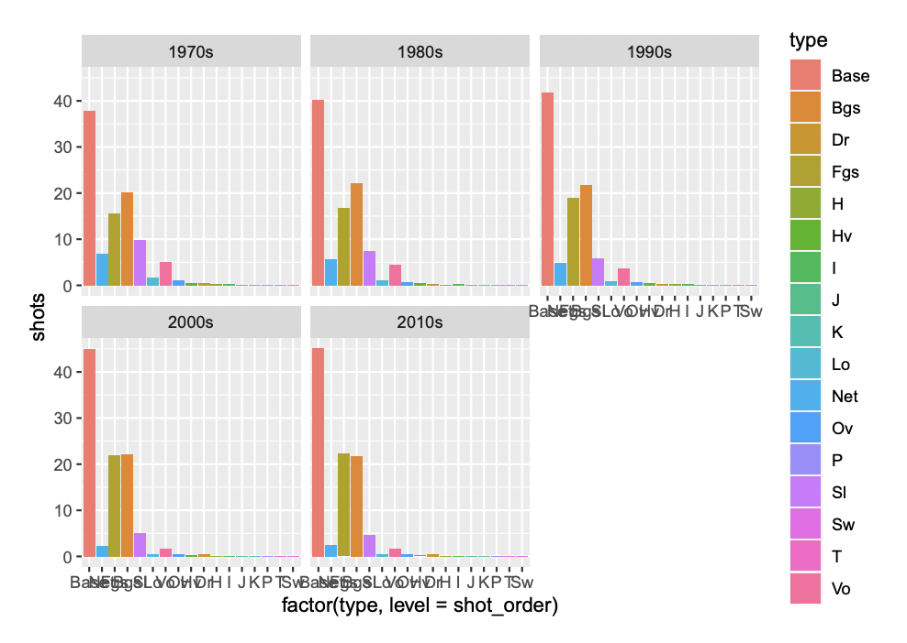
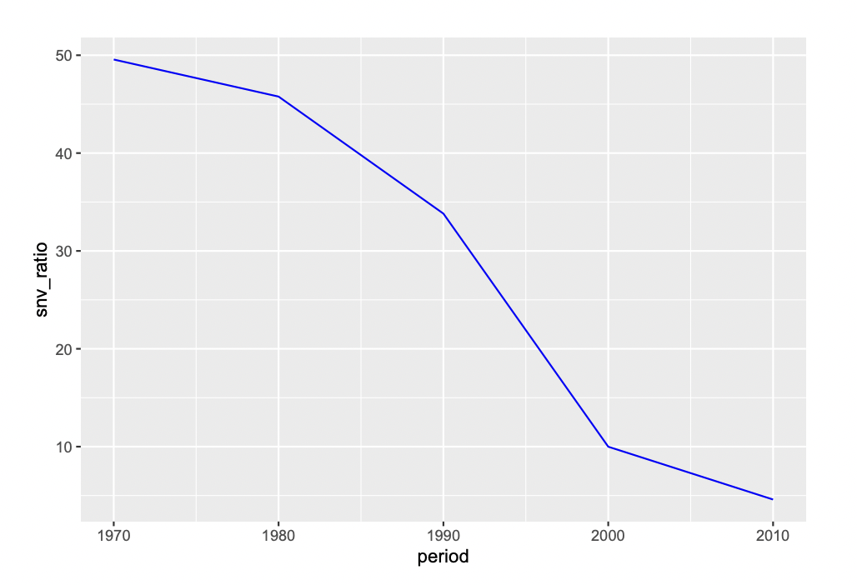
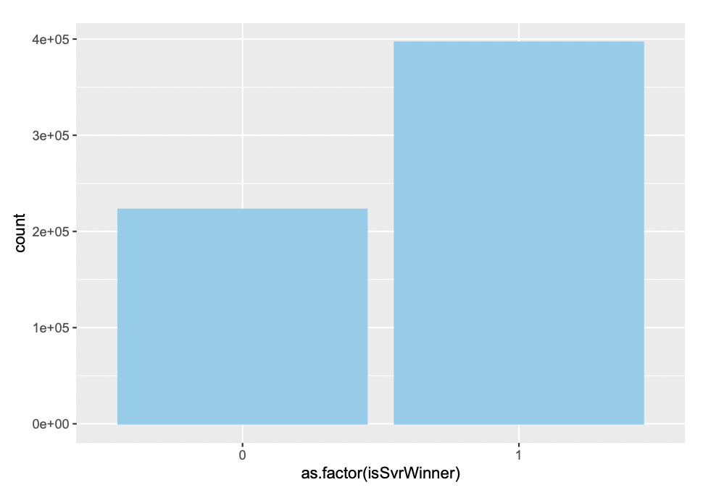
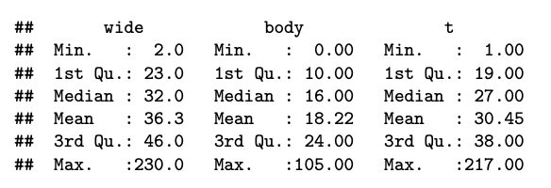
4. EDA
Changes in the types and frequency of shots according to the times
Proportion of S&V play according to the period
Difference in scoring according to server/receiver
Summary about the serve direction

Slide 8
5. Modeling & Analysis
Linear
Regression
K-NN
Clustering
Logistic
Regression

Slide 9
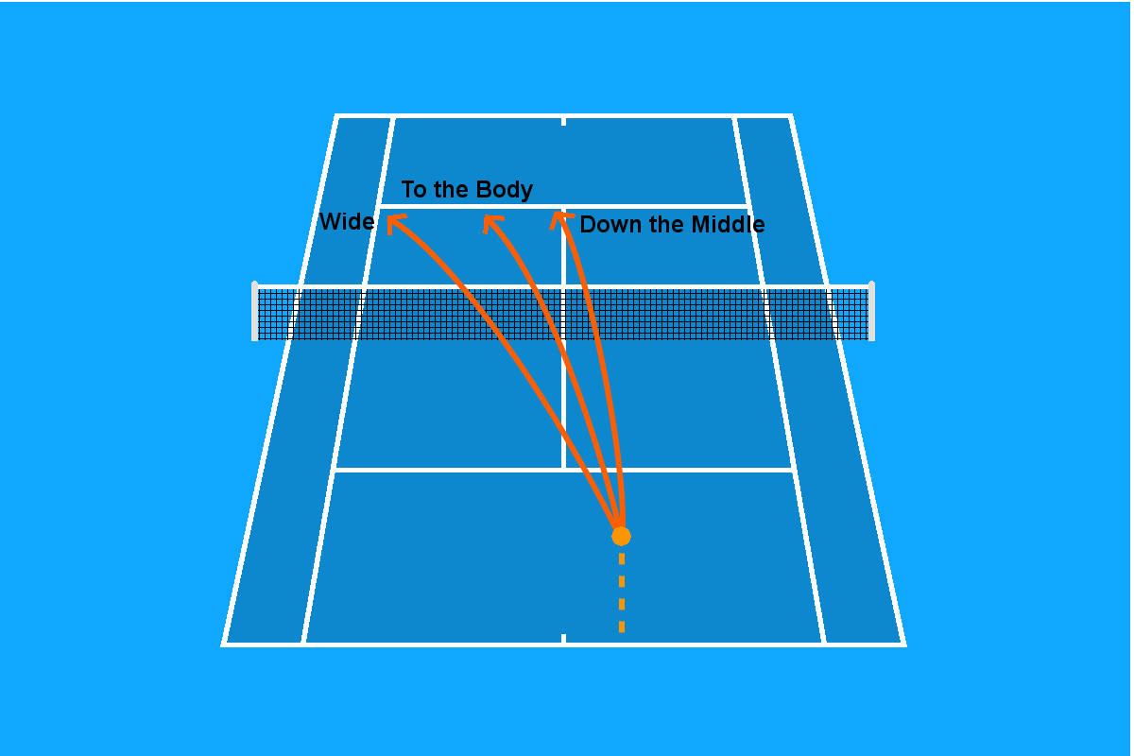

5. Modeling & Analysis – (1) Linear Regression Analysis
Wide serve , T serve
Body serve
>>

Slide 10
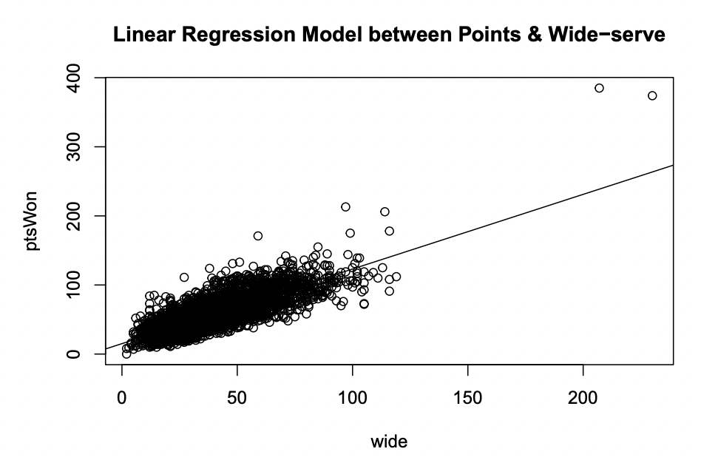
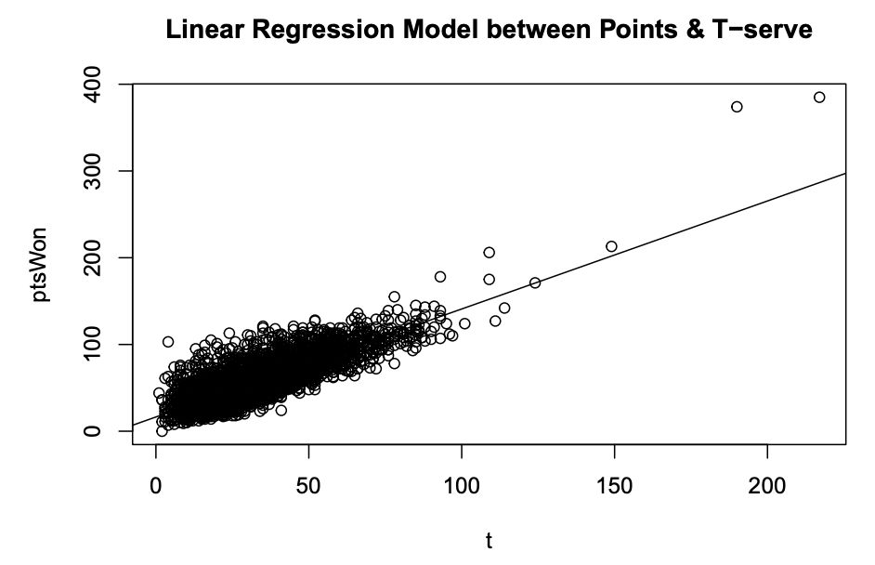
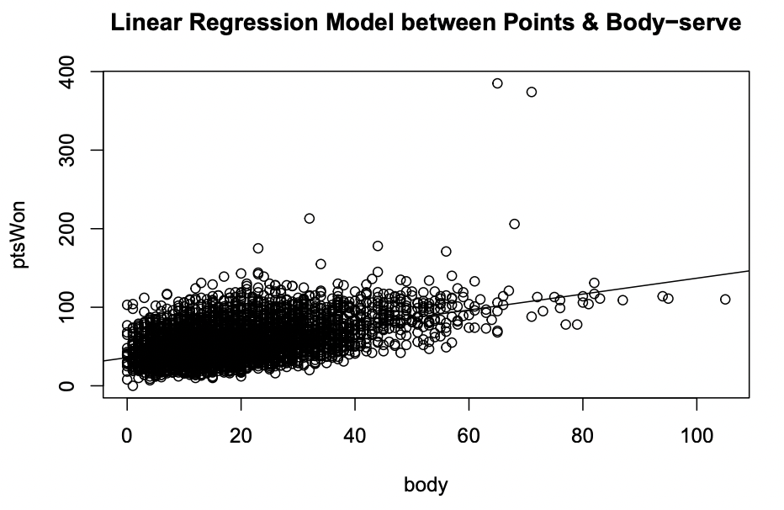
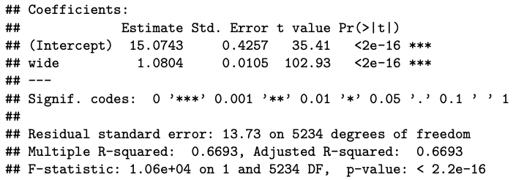
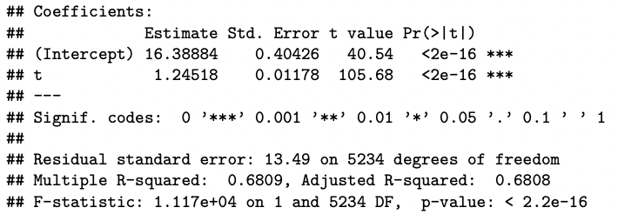
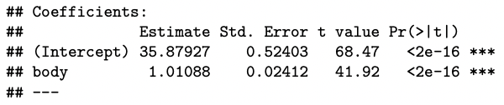
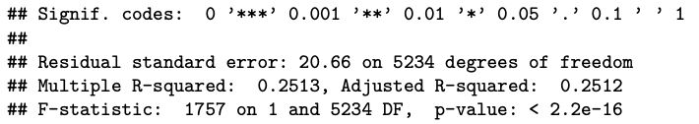
5. Modeling & Analysis – (1) Linear Regression Analysis

Slide 11
5. Modeling & Analysis – (1) Linear Regression Analysis
The more you do either Wide-serve or T-serve than Body-serve,
the more likely you are to score lots of points!

Slide 12
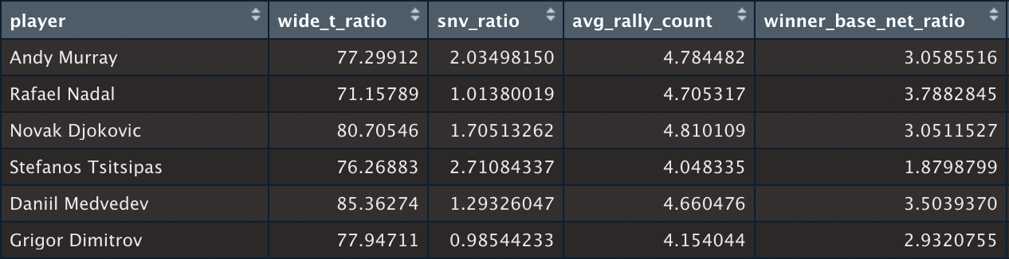
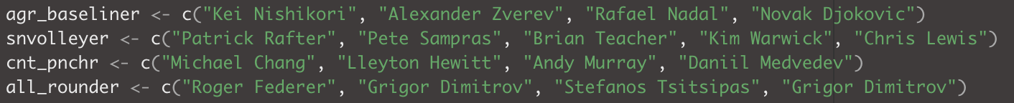
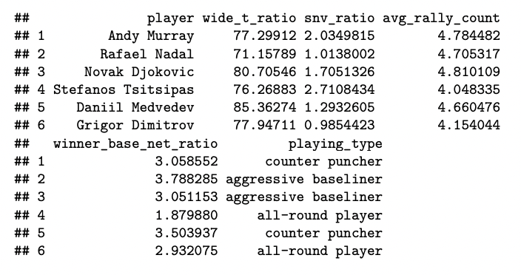
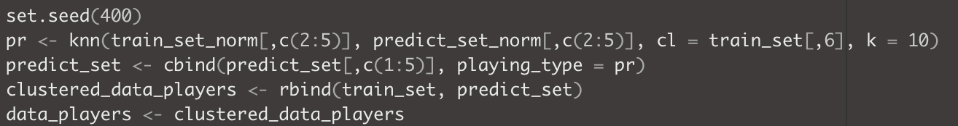
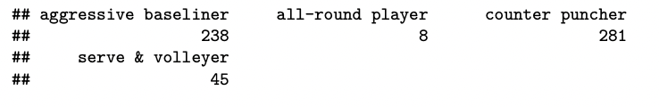
5. Modeling & Analysis – (2) K-NN Clustering
Clustering tennis players in 4 types
Choose several stats that distinguish each type well
Label the most representative players of each type and use them as criteria (supervised learning)
Use clustering model to distinguish which type each of
the 700 players is most similar
Criteria
Labeling
Result of clustering
Part of K-NN modeling

Slide 13
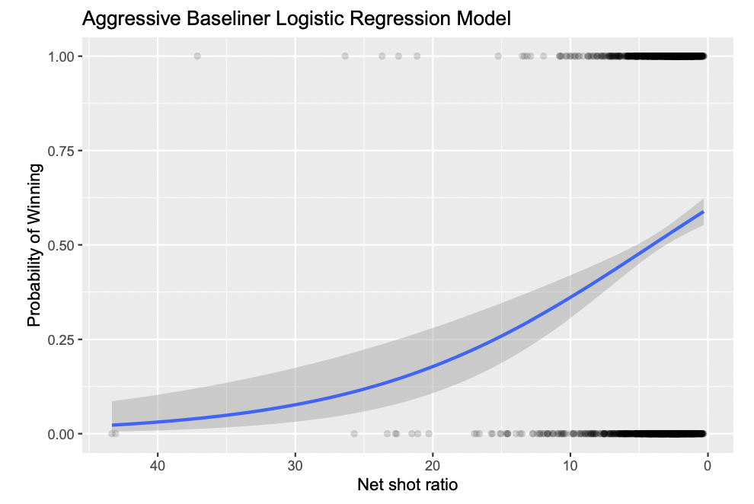
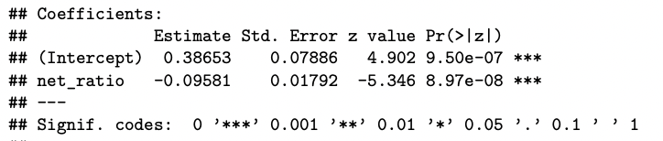
5. Modeling & Analysis – (3) Logistic Regression Analysis
Verifying traditional winning strategies
1) Aggressive Baseliner
It is a type that leads the game with a strong forehand
near the baseline
To defeat this type,
make them hit more shots near the net
Almost true!
😀

Slide 14
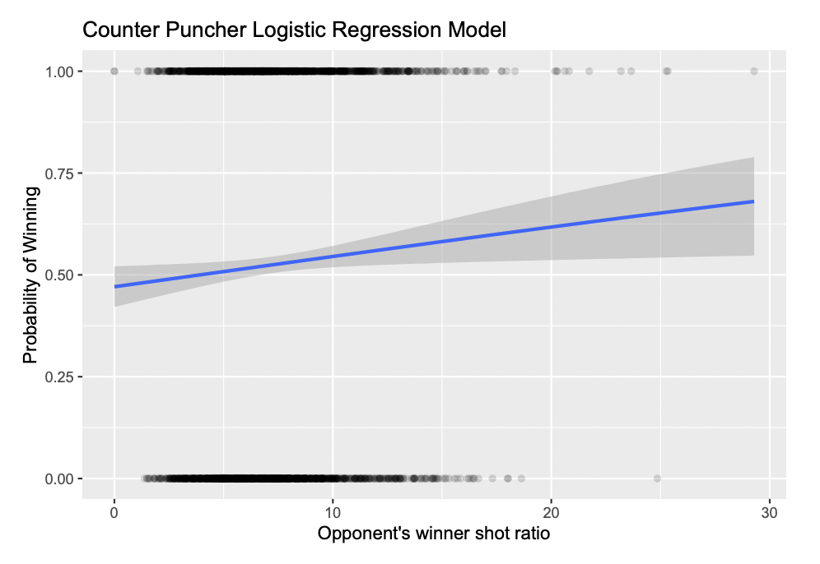
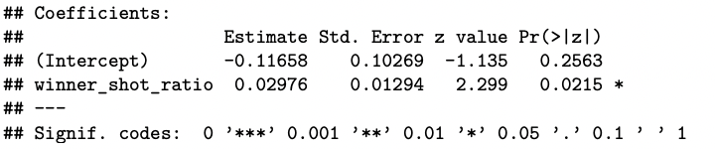
5. Modeling & Analysis – (3) Logistic Regression Analysis
Verifying traditional winning strategies
2) Counter Puncher
They are usually good at defense and seeks for opponent's mistakes or a decisive winner shot
To defeat this type,
lead the game calmly and don't rush to finish the game
A little correlation…?
🤔

Slide 15
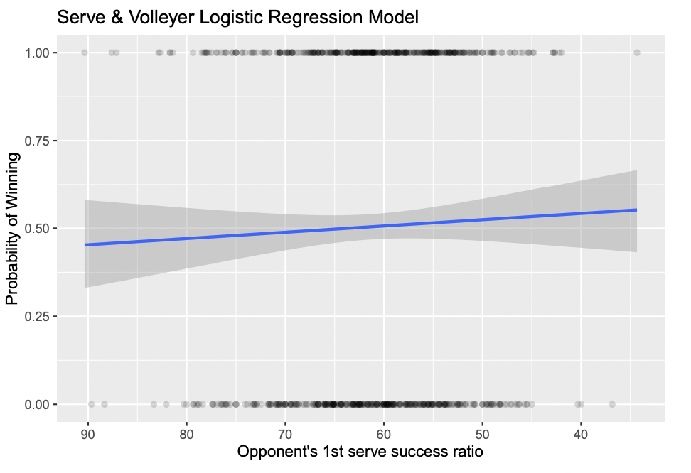
5. Modeling & Analysis – (3) Logistic Regression Analysis
Verifying traditional winning strategies
3) Serve & Volleyer
It is a type that tries to finish the game in short rally, mainly by trying frequent net play
To defeat this type,
Make a strong first serve so they can’t do the net play easily
No correlation…
🥲

Slide 16
5. Modeling & Analysis – (3) Logistic Regression Analysis
Verifying traditional winning strategies
3) Serve & Volleyer
It is a type that tries to finish the game quickly, mainly by trying net play
To defeat them,
Make a strong first serve so they can’t do the net play easily
In the case of AB, there was a valid correlation!
But in the other two, the strategy could not be seen as fully verified.
However…
No relationship…
🥲

Slide 17
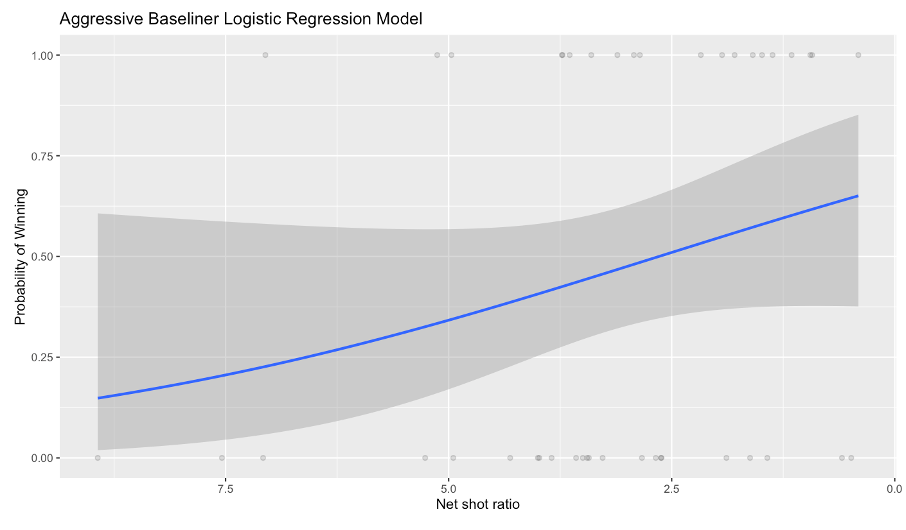
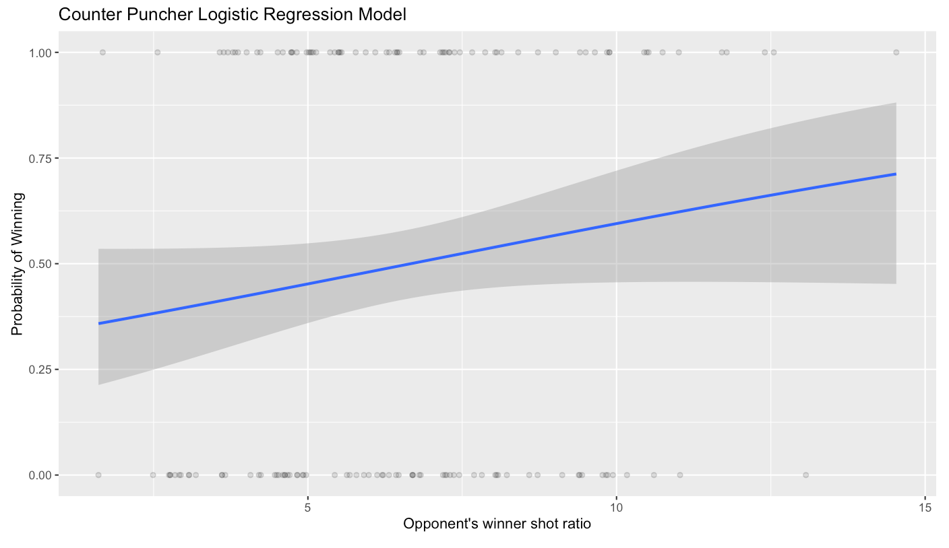
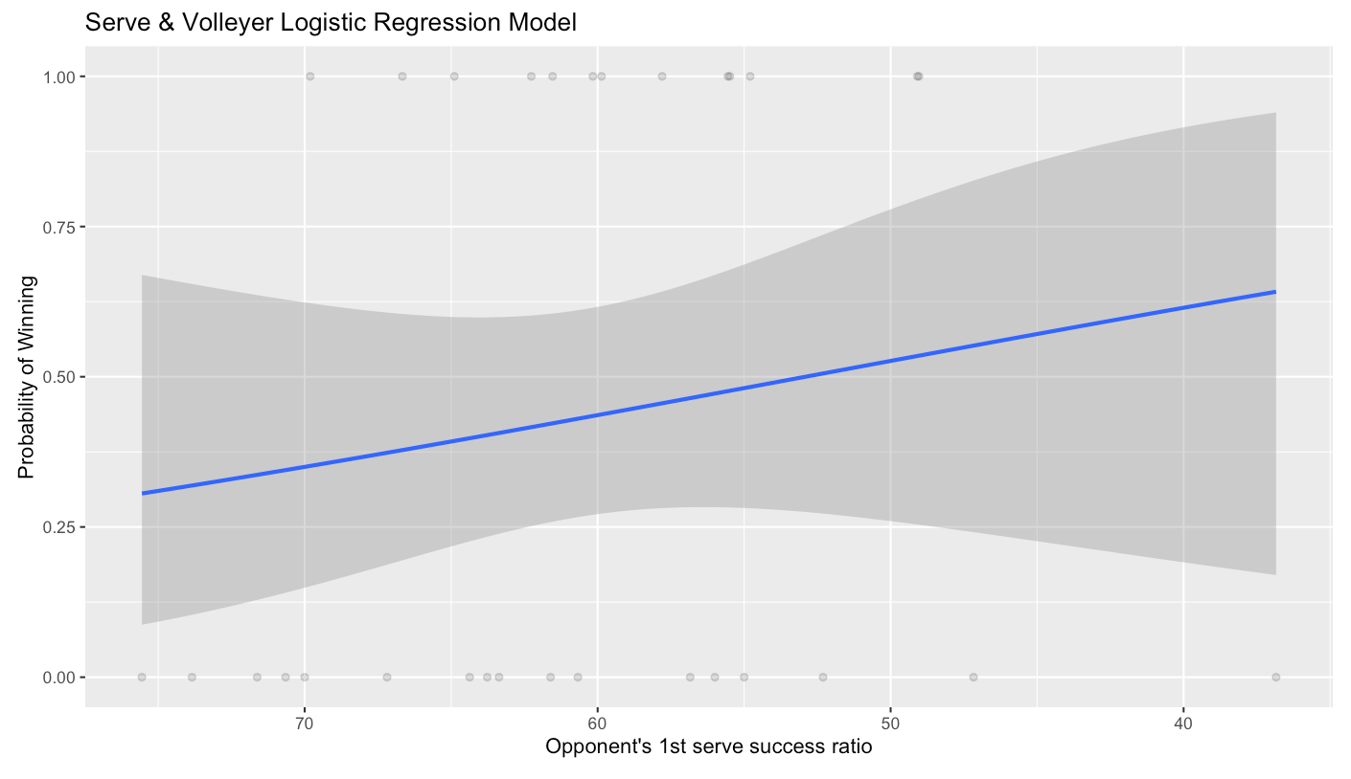
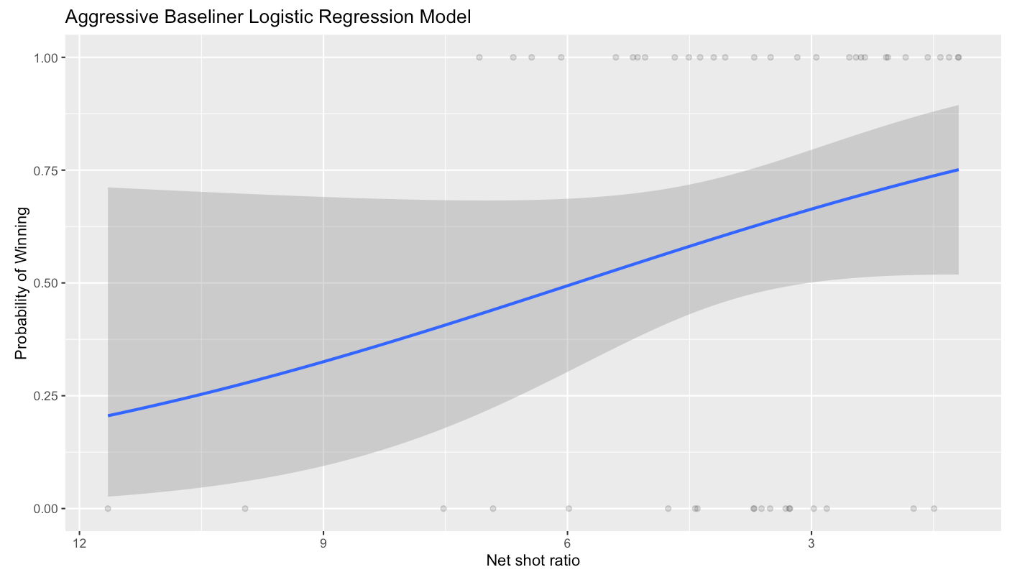
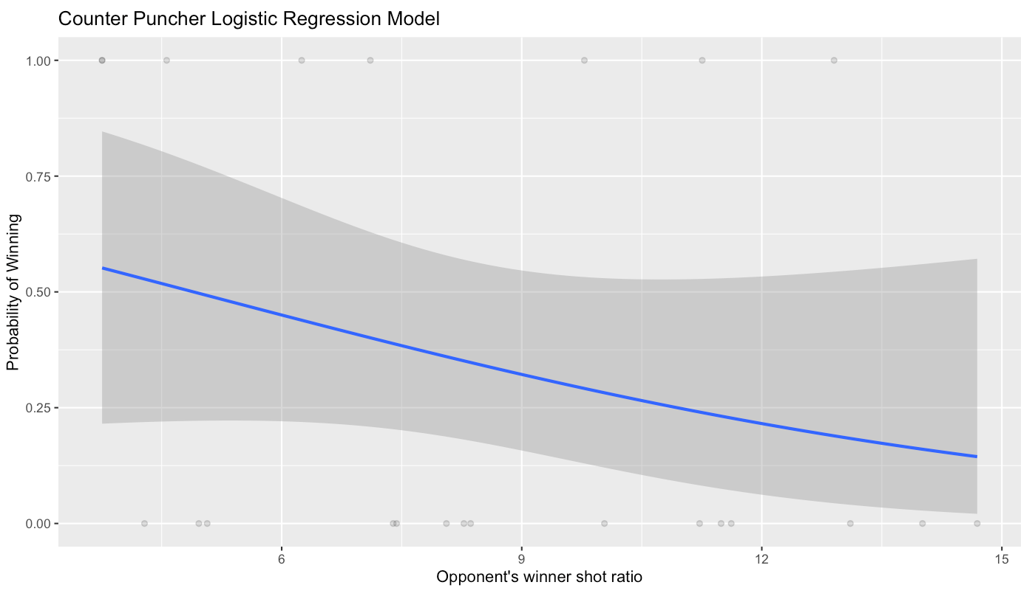
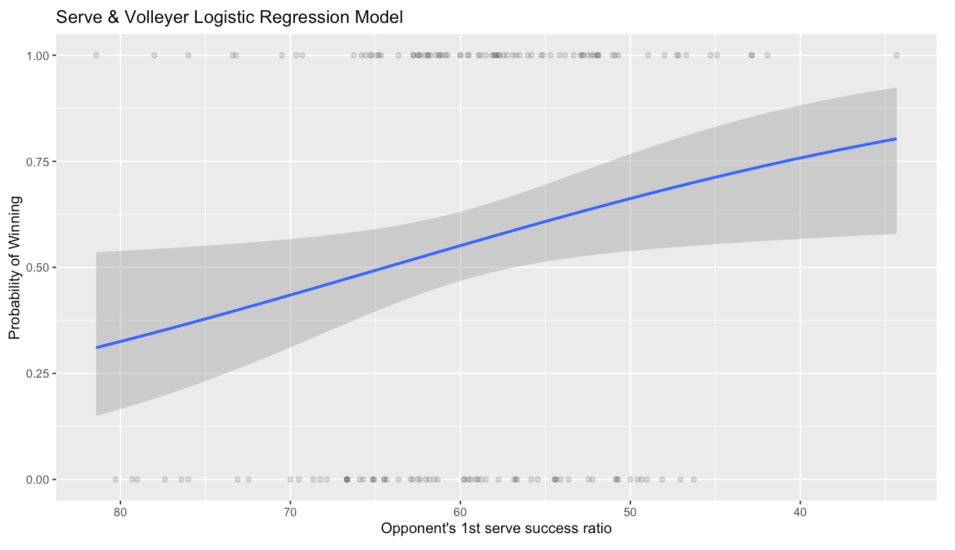
6. Data Product
Aggressive Baseliner
Counter Puncher
Serve & Volleyer
complete outlier...

Slide 18
7. Conclusion
0 1
As a result of clustering, the distribution of players’
types was almost the same as is generally known
Aggressive Baseliner = Counter Puncher >>>> Serve & Volleyer >> All-round Player
0 2
Some traditional winning strategies didn’t fit well with the real data.
But for representative players in each type,
the strategies tended to fit better.

Slide 19
Thank you!

